Slide 1
Smart Card Security Check _________________________________________________________________________________________________________________________________________________________
Visitor Identification System

Slide 2
Overview
The Project is going to be an Integrated system for handling Visitors visiting an Organization or a Company (Generalized for all Institutions).
It will automate the workflow involving the Host, Departments, Administration, security and Visitors.
It is designed to simplify the administration and thereby provide a minimally intrusive experience to the visitor and the host.
It will be a Web Application containing information about visitors, assigning valid IDs to them by a mandatory host.

Slide 3

Organization Interfaces
Administration
Host
Security & Surveillance unit
Department
Employees
Visitor

Slide 4

Visitor Parameters
Name
Address
Contact Details
Identification
Grey Listing
New visitor / Not new

Slide 5

Visit Paradigms
Visitor ID
Visit Date
Concerned Department
Concerned Person / Employee
Purpose for Visit
Check In & Check Out timings

Slide 6

The Smart Card
After approval of meeting from department and security, the visitor will be provided with a Smart Card, which will be written with the primary information of visitor.
Whenever the visitor passes through a gateway, the card is automatically scanned and the real time information in sent to the security.
Thus, the activities of Visitor are monitored.

Slide 7
Visitor Data Classification
Primary data: This is the data for which the visitor is the owner and hence the authentic source. E.g. Profile information, Contact details, Visit Details, etc.
Facilitating data: This is the data fed by the institute departments interacting with the Visitor Information System to facilitate the visit. E.g. Local contact details, Approval Information, etc.
Secondary / Real-time data: This is the real-time data fed/updated in the system by the security personnel. E.g. Activity Monitoring, etc.

Slide 8
Data Manipulation Constraint
Under no circumstances primary data can be altered by anyone other than visitor. The administrator can lock the data once he/she is convinced that the primary data entry is over. Once a record is locked, even if the visitor wants to change the primary data, the administrator permission has to be sought to open the record again for editing.

Slide 9
Data Privacy
Since the application has all sensitive and personal information regarding the visitor, data privacy is utmost important and is taken care of. The data in totality is not made available to any entity other than the Visitor Information System administrator to even view. Departmental staff who have access to the system have access to only that part of the visitor data which they need to know about and also on which they need to act upon.

Slide 10
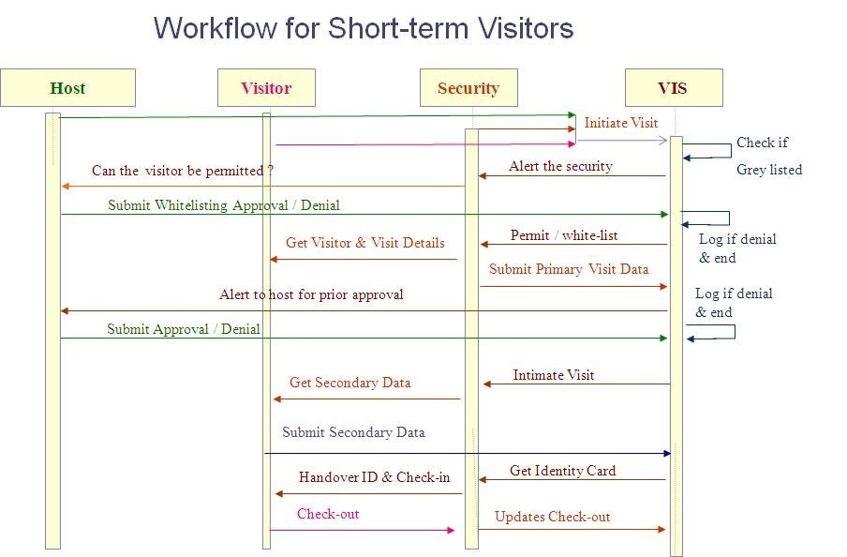
Visitor Workflow

Slide 11
Visitor Workflow

Slide 12
Add a Slide Title - 4

Slide 13
Add a Slide Title - 5

